Slide 1

Cheshire East Parent Carer Forum AGM 2025

Slide 2

AGENDA – AGM 2025
Arrival & Coffee | 10.00 am
Welcome and housekeeping | 10.15
Cheshire East SEND Transformation update – Keith Martin, Cheshire East Strategic Transformation Lead for SEND | 10.20
Update on Inclusion – Andrea Phelps-Brown, Cheshire East Inclusion Quality Team | 10.40
Preparing for Adulthood – Louisa Joyce, Cheshire East Designated Social Care Officer for SEND. | 11.00
Coffee break | 11.20
Chairs Update Cheshire East Parent Carer Forum | 11.30
Financial Update CEPCF | 11.50
Elections for CEPCF Steering Group Officers | 12.00
Finish | 12.30

Slide 3
Housekeeping
Toilets
Fire alarms
Notes:
Questions about the strategy and general processes are very welcome (although this is not the space for individual issues)

Slide 4

What is a parent carer forum ? Background and context

Slide 5


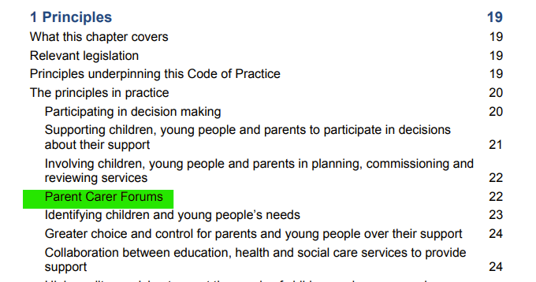
What is a Parent Carer Forum?
Children & Families Act 2014 / SEND Code of Practice 2015
“Parent Carer Forums are representative local groups of parents and carers of children and young people with disabilities who work alongside local authorities, education, health and other service providers to ensure the services they plan, commission, deliver and monitor meet the needs of children and families. Parent Carer Forums have been established in most local areas and local authorities are actively encouraged to work with them.”
Notes:
https://www.youtube.com/watch?v=O9Pf-JsFuJk
https://contact.org.uk/help-for-families/parent-carer-participation/what-is-parent-carer-participation/

Slide 6
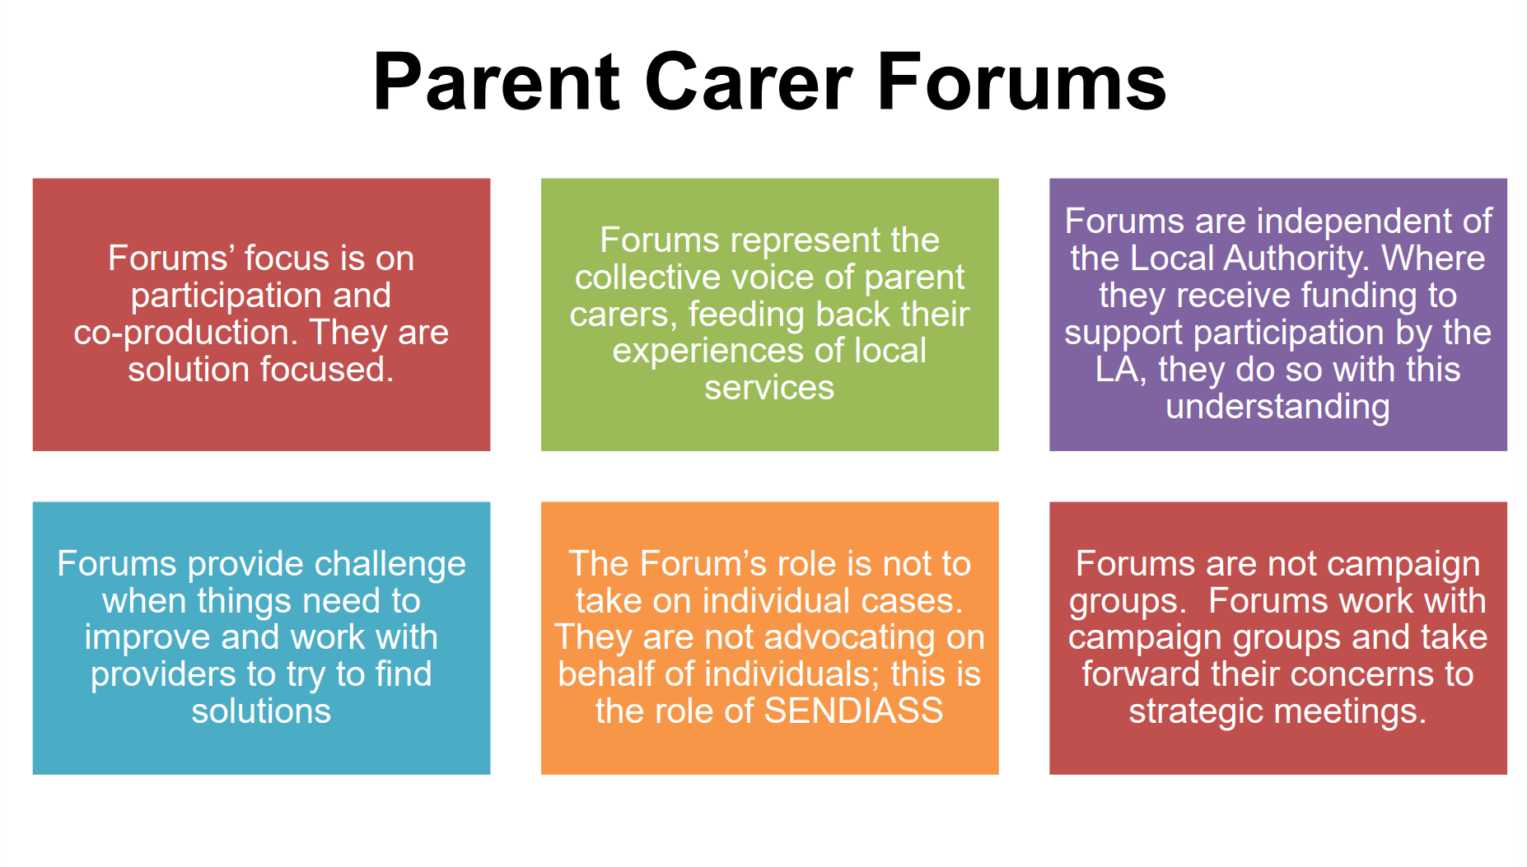
Slide from Contact​
Notes:
Tax-payer funded by central grant – managed and monitored by Contact on behalf of the DoE..

Slide 7

Slide from Contact​

Slide 8
What do we do in Cheshire East?
Some of things we do……
  We gather member views about local services, health and social care and feed this back to them, telling them what matters to help improve services across Cheshire East
  We put on FREE training for our members - including around sleep, dyslexia, EHCPs, SEN Support etc
  We run our Facebook group which offers peer support, advice and signposting
  We host our website which is updated with local SEND News, our training offer and we are slowly adding more resources to the site
  We offer a FREE max card to members – a discount card for families with children with SEND
  We attend coffee mornings
  We are all parent carers ourselves and are a member led organisation.

Slide 9

CEPCF – 2025-2026 update

Slide 10

Update: What has Cheshire East Parent Carer Forum done in 2024-25

Slide 11
CEPCF Participation
Who? Any parent-carer with a child or young person (age 0-25) with additional needs, living in Cheshire East can join the Parent Carer Forum
We have over 1859 members on the mailing list, this has more than doubled over the last 2 years.
Our closed Facebook Group has 4400 members: This has more than doubled since 2023.
It offers peer support, sharing information and advice, good news stories and rants.
Our public Facebook Page has over 2100 followers: sharing information and links publicly. This has nearly tripled since 2023.
All our volunteers are members of the Parent Carer Forum – we are all parent carers ourselves
We have a steering group that works together to agree how we use our resources and volunteers to represent our members most effectively.
*We always welcome any new volunteers*

Slide 12
Cheshire East Parent Carer Forum:
In 2024-25 we have:
Organised community events with local businesses for families to attend
Put on 26 training sessions covering subjects including
Sleep,
Sensory needs,
Dyslexia support,
Wills/Trusts
Financial Planning
Relationships and Sex Education for SEND Families.

Slide 13
Cheshire East Parent Carer Forum: 2024-25
We have shared information, news, events and updates with Cheshire East parent carers
Maintained our parent/carer-only Facebook group as a safe space for peer support and advice
We have continued to use our public Facebook page to share information more widely
Sign-posted parent carers to support and information
Sent members’ updates to share information, news, events and updates

Slide 14
Cheshire East Parent Carer Forum: 2024-25
We have put on/attended:
21 in person events including:
School coffee mornings,
Parent engagement events
Been part of drop-in support sessions for families on waiting lists for ADHD and Autism assessments.
Preparing For Adulthood/ transition events at Family Hubs.
In addition, we have hosted 5 face to face or virtual events with CEIAS about the SEND Toolkit for Inclusion, and the EHCP process

Slide 15
Cheshire East Parent Carer Forum: 2024-25. Parent carer participation.
We have attended over 170 coproduction meetings with the local authority, health and social care in the last financial year.
This includes meetings about:
Transition,
Training,
Family Hubs,
PCF Cluster meetings with the ICB,
Short Breaks,
SEND Partnership Board,
High needs Funding/Banding meetings,
PINS,
Catch ups with senior leaders at CE,
Inclusive practice,
Health and Care Partnership Board and CAMHS.

Slide 16

Partnership for Inclusion of Neurodiversity Pilot (PINS)
The Partnerships for Inclusion of Neurodiversity in Schools (PINS) project is a collaborative initiative aimed at enhancing the educational experience of neurodiverse children within mainstream primary schools.
The PINS project was inspired by the success of the national Autism in Schools (AiS) project
Its goal is meeting the needs of children with Special Educational Needs and Disability (SEND) in mainstream schools.
By fostering collaboration between health and education specialists, expert parent carers, and schools, PINS aims to improve outcomes across attainment, attendance, and well-being.

Slide 17
Partnership for Inclusion of Neurodiversity Pilot (PINS)
What have we done so far?
  Helped Identify 5 schools to be part of the project – this was done on a variety of reasons, such as high SEND numbers, willingness to engage etc
  Schools have completed self assessment paperwork
  Sent out a parent carer survey to all parents within the 5 schools and analysed the results
  Held coffee mornings within the chosen schools to inform them about the project

Slide 18
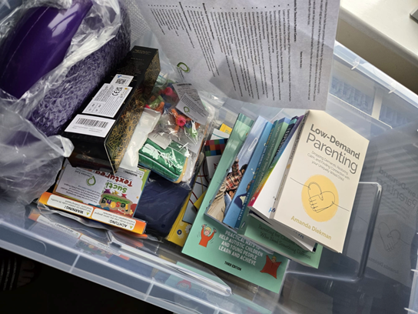
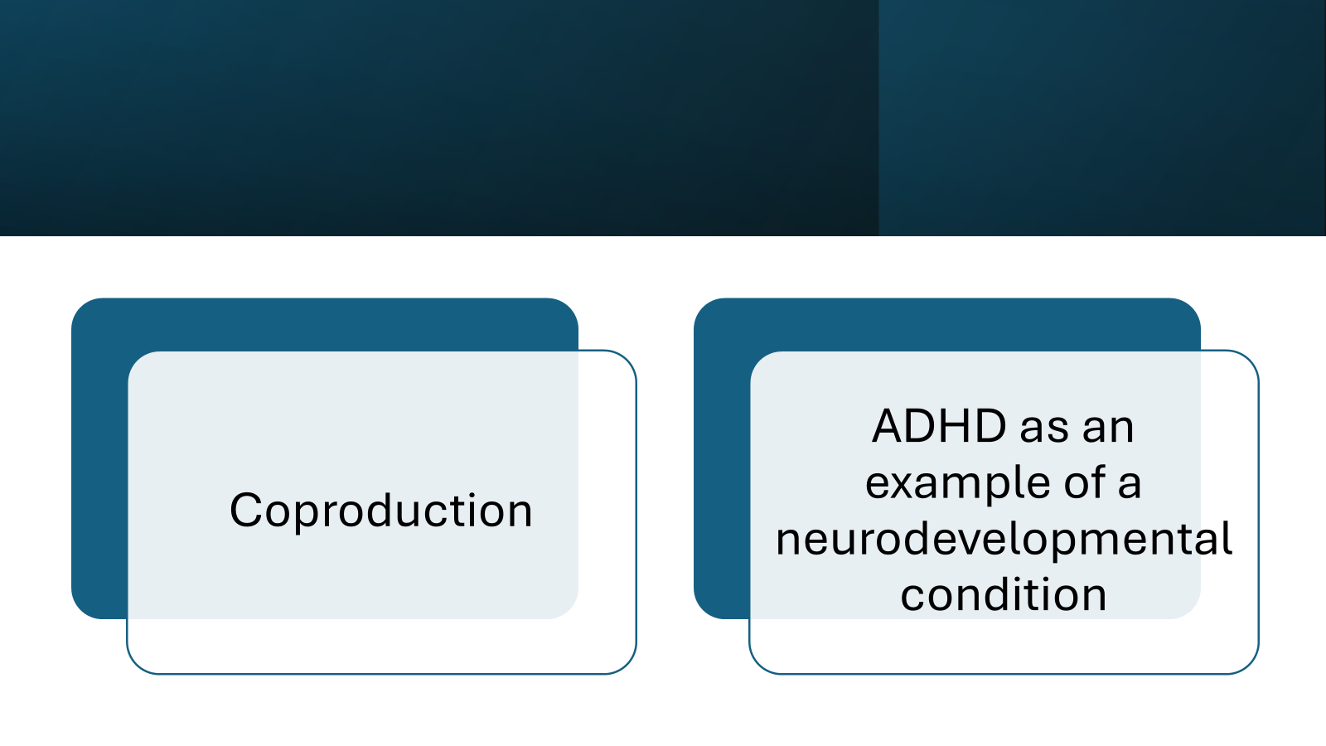
Partnership for Inclusion of Neurodiversity Pilot (PINS)
We have helped deliver the training programme for schools taking part in the project covering “understanding needs in the classroom”
Had follow up coffee mornings with the schools taking part, discussing subjects such as ADHD and coproduction.
Created resource boxes for the PINS schools – which include books on neurodiversity and sensory equipment.

Slide 19
Cheshire East Parent Carer Forum:
What next?
We will:
  Keep representing the views and experiences of parent carers in Cheshire East
  as part of the CE SEND Partnership
  Keep listening to our members - if we don't hear from you, we can't share
  your views and lived experiences, so please keep talking :)
  Provide more training sessions and workshops for members (topic requests very welcome!) so they are informed and empowered
  Continue to share information, events and updates via members’ updates, Facebook and regular blogs on our website to keep members informed of what is happening and what’s new.
  Share information updates and resources to support members to
  participate

Slide 20
CEPCF – Listening to our members
In order for the Steering Group to plan training and information events, and for Parent Representatives to do their job, we need to hear about parent carers’ experiences and views of SEND Services in Cheshire East
Members can contact us
Joining in discussions (coffee mornings, Facebook group etc)
Asking for feedback / “focus groups” on specific experiences
Carrying out surveys
Notes:
While we don’t pick up individual’s complaints, this does give us an overview so we’re able to identify common themes where systems and processes could be changed to make things work better
Members also contact us with suggestions and requests
We join in discussions – we are all parent carers too.

Slide 21
Cheshire East PCF
Treasurer’s Report 2024-25

Slide 22
Grant Expenditure
2024-2025
Area | Spend in £
Events | 416.00
Meetings | 144.75
Training | 1533.00
Staffing Costs | 8342.27
Hard to Reach | 3090.00
Infrastructure | 1662.91
Develop info/resources | 384.00
Web Development | 540.00
Parent Carer Expenses | 1364.03
Other | 23.80
Total Spend | 17,500.76
Remainder | -0.76
Total Money Received: £17,500
Total Expenditure : £17,500.76
Total Underspend £ -0.76

Slide 23
PINS Expenditure
2024-2025
Items | Spend in £
Coffee Ams | 13.55
Resource Boxes for Schools x 6 | 2681.05
Raffle Prizes for Schools | 335.35
Total Spend | 3029.95
Underspend | 5110.05
Total Money Received: £8140.00
Total Expenditure : £3029.95
Total Underspend £5110.05

Slide 24
What are we planning to do in 2025-6?
We want to increase our volunteer group
Improve our website.
We would like to hold more face to face events across Cheshire East
We would like to look at reaching out to underserved communities
We would like to continue:
Representing members views to coproduce SEND pathways and services
Holding coffee mornings with schools/community groups/Local authority
Holding training sessions
Working on specific projects including :
Improving the Short Break Offer
Working with the NHS on creating better ARFID community resources.
Working to improve communication on what mental health support for children ad young people is out there

Slide 25
Formal appointment of officers and steering group
Quick reminder that we would welcome any new volunteers

Slide 26
Formal appointments to be voted on.
Stepping down
As Co-Chair – Chris Jaydeokar
As Co-Chair – Kayla Sellors
Standing
For Chair – Sarah Simpkin
For Co Vice Chair Danielle Parkinson
For Co-Vice Chair – Chris Jaydeokar
Parent Engagement Lead.
For Treasurer – Kayla Sellors

Slide 27
THANK YOU FOR JOINING US TODAY!

