Slide 1


Preparing for Adulthood in Health Services
Penny Teale
Designated Clinical Officer
NHS Cheshire and Merseyside ICB
penny.teale@cheshireandmerseyside.nhs.uk

Slide 2
What do we mean by Health?
Audiology/Ophthalmology
End of life/palliative care
Occupational Therapy
Physiotherapy
Neurodevelopmental and learning difficulties
Dentists
Learning Disability Nursing
Speech and Language Therapy
Continuing Healthcare
Child or young person
Mental Health and wellbeing
Physical Health
Primary Care e.g. GP
ASC/ADHD assessment and support
Paediatricians
Specialist Nursing services
CAMHS
/support for mental health
0-19 (25) service

Slide 3
Health and transition
NICE Guideline NG43
Transition from children’s to adults’ services for young people using health or social care services
Overview | Transition from children’s to adults’ services for young people using health or social care services | Guidance | NICE
Notes:
NICE clinical guidelines: provide recommendations for the treatment and care of people by health professionals. are used to develop standards to assess the clinical practice of individual health professionals. are used in the education and training of health professionals. help patients to make informed decisions.
This guideline covers the period before, during and after a young person moves from children's to adults' services. It aims to help young people and their carers have a better experience of transition by improving the way it’s planned and carried out. It covers both health and social care.
NICE has developed information for young people and their carers to help them to understand what good transition should include and look like. This information explains what care young people and their parents or carers should expect from children's and adults' services during transition. It suggests questions to ask, and where to find further help. It has a list of questions that you can use when you are going into meetings to give a prompt to the types of things you might want to ask.
Transition doesn't start at the same age for everyone. It will depend on your care and support needs and what seems right for you. It will also depend on what the law says about different services.
The people who provide your care and support should involve you and your parents or carers at every stage of your transition. They should make sure you have the information you need to make decisions. The information should be easy for you to use and understand.
They should help you to choose a person to act as a link between you and the various staff who support you, including your GP. This person, called a 'named worker', should be someone you already know and get on well with. The named worker will be your main contact until a few months after you've transferred to adults' services.
Your named worker should discuss with you:
what to expect
how you can be fully involved in your transition and control what happens
what your care and support options will be after you transfer
any assessments you may need to have
what help is available before, during and after the transfer; this could include:
peer support (support from other young people who have experience of transition)
advocacy (support from someone independent from children's or adults' services, who can represent your interests)
information about different ways to manage your care and support, including funding (if you're eligible for this)
who to speak to if you're worried or have questions.
According to the NICE Guidelines, transition planning should start at age 13 or 14 (Year 9) for young people with an Education Health Care Plan (EHCP) plan. It is beneficial to start transition planning earlier for young people with complex health needs to adequately prepare.

Slide 4
Principles to Support PFA / Transition
The annual review in Year 9 is key.
Be proactive and ensure anyone involved with your young person is invited to the review and is asked for a report. Health staff are asked to prioritise Year 9 review.
Communication needs to be effective and meaningful between all parties to achieve a safe and timely transition to adult services
The young person and their needs, aspirations and wishes should be central to all transition planning.
It is important for health professionals to assess and identify the young person’s needs at the point of transition and explain to the young person and the family how these will be met in adult services.
Notes:
You may feel unsure about the idea of moving to a new service, especially if you've been with children's services for quite a while. Your named worker can help you find ways to get familiar with the new services before you transfer. This could include:
meeting some of the people who will be supporting you in adults' services
going to a joint clinic involving people who work in children's and adults' services
visiting adults' services
trying peer support or mentoring
talking with other young people who have experienced transition to adults' services.
You could also put together some information about yourself, so the people in adults' services can get to know you as a person before you transfer. The information could include details of your education, health and care needs (including the name of your GP), and your achievements, goals and hopes for the future. You could either do this yourself or involve your parents, your named worker or someone else you trust.
Children's and adults' services should both take responsibility for your transition. They should work together to ensure you have a smooth and gradual move from children's to adults' services. They should work closely with your GP and any other services that support you.
If you have an education, health and care (EHC) plan, health and social care services should work closely with education. This will help to make your transition go more smoothly.

Slide 5
Role of the GP.
The GP is often a constant figure as young people transition between services.
Young people with SEND with a learning disability should be included on the GP register. This means they are automatically called for an annual health check from the age of 14.

Slide 6
Annual Health Check
To be eligible, a young person must be:
- aged 14 and over
- on the GP practice learning disability health checks register
Learning disability annual health checks are different from the wider NHS health check scheme. The learning disabilities health checks are designed to pick up a wider range of unmet health needs whereas the latter is intended to help individuals reduce their risk of heart disease, stroke, diabetes and kidney disease.
Learning disabilities health checks can help people with learning disabilities to use health services better by understanding what their local GP service can provide for them and learning how to use it.

Slide 7

Harshi’s learning disability annual health check and health action plan (youtube.com)

Slide 8
Reasonable Adjustments
Reasonable adjustments are a legal requirement to make sure health services are accessible to everyone who requires them.
The Reasonable Adjustment Digital Flag is a national record which indicates that reasonable adjustments are required for an individual and includes details of the key adjustments that should be considered and underlying conditions.
It applies across NHS and independent providers, social care (as providers) as well as independent contractors such as GPs and dentists.

Slide 9
Mental Health
Consider a keep safe and cope well plan - keep safe and cope well plan (PDF, 950KB)
If you are open to CYP mental health services (CAMHS), ensure you speak to your practitioner about the plan for transfer to adult mental health services if you require ongoing specialist level help.
24/7 all age urgent mental health helpline has a Freephone number - 0800 145 6485. An online support hub is also available.
My Mind website offers a wide range of support and advice on mental health, neurodiversity and emotional wellbeing - Parents and carers :: Cheshire and Wirral Partnership NHS Foundation Trust (mymind.org.uk)
Notes:
The keep safe and cope well plan (PDF, 950KB) encourages children and parent/carers to find solutions to problems they are facing and try new coping skills and interests. This piece of work has been co-produced with children and young people in Cheshire East and is available for all Primary and Secondary schools. A child led approach that recognises emotional difficulties, promotes problem solving, identifying protective factors, and building resilience at both school and home.

Slide 10
Cheshire and Merseyside PALS
(Patient Advice and Liaison Service)
Telephone: 0800 132 996
Email: enquiries@cheshireandmerseyside.nhs.uk
Post:
Patient Experience Team
NHS Cheshire and Merseyside
No 1 Lakeside
920 Centre Park Square
Warrington
WA1 1QY
Notes:
Listening to families is absolutely vital in improving patient experience for everyone in Cheshire and Merseyside.
PALS covers almost all health services we mentioned right back at the start.
Any comments on the health services or on decisions the ICB makes, whether that is a complaint, idea or compliment are welcomed using the contact details here.
Your feedback helps shape the best possible care and treatment.

Slide 11
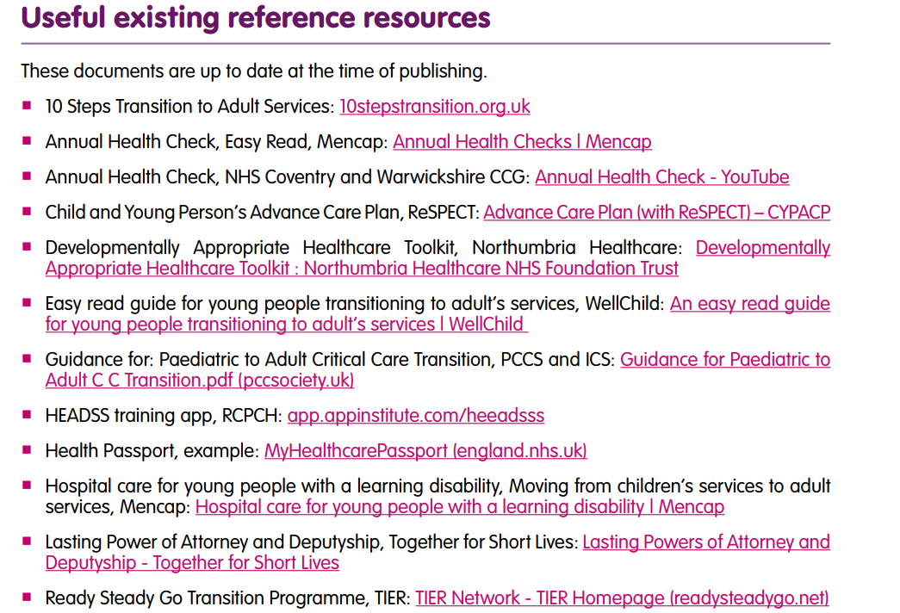
Notes:
References taken from the wellchild principles from transition framework which is a really useful resource, especially for those with complex health needs.

Slide 12

Any questions?

